Slide 1
Convolutional Neural Networks for CAP4453

Slide 2
Recap
From previous lecture:
Neural Networks receive an input (a single vector), and transform it through a series of hidden layers.
Each hidden layer is made up of a set of neurons, where each neuron is fully connected to all neurons in the previous layer.
Neurons in a single layer function completely independently and do not share any connections.
The last fully-connected layer is called the “output layer”

Slide 3
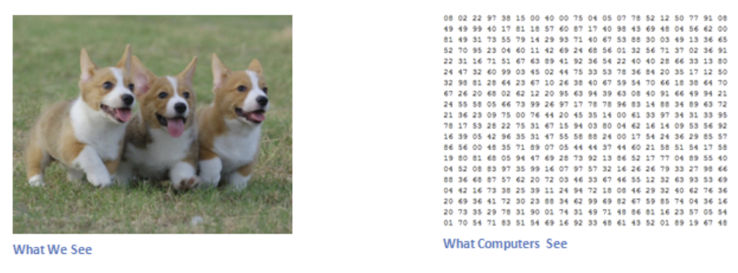
Input image
Our task in computer vision is to make sense of these numbers as humans do and beyond that.
Convolutional Neural Network are one set of algorithms popular used to solve these tasks.

Slide 4
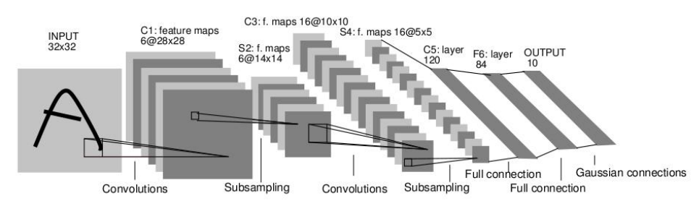
Introduction
Convolution Neural Network (CNN)
First successful architecture developed for image recognition was LeNet.
LeNet was developed by Yann LeCun in 1998.
It classifies digits, and was applied by several banks to recognise handwritten numbers on checks (cheques) digitized in 32x32 pixel images.
LeNet Architecture:
Softmax
Notes:
Softmax!

Slide 5
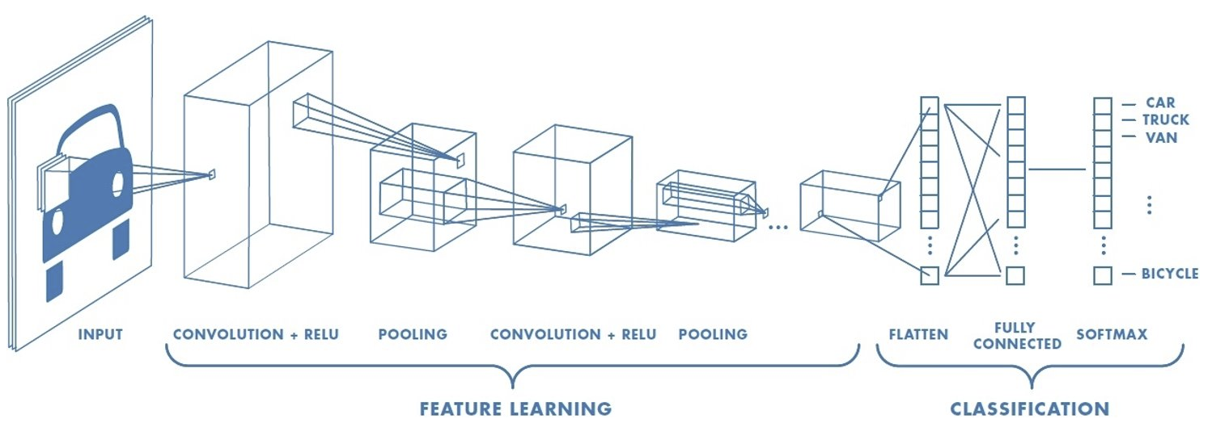
Example of Modern representation of CNN
Notes:
Convolution depth details

Slide 6
Introduction to CNN
Core building block of CNN is called Convolutional layer (Conv layer).
Convolutional layer perform convolution operations.
These operations are performed using set of filters.
These filters are learnable parameters for the network.
Every filter is small matrix that extends through the full depth of the input volume.
These filter parameters extract complex features from your data.

Slide 7
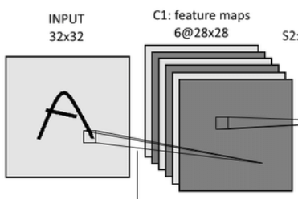
Representation of Convolution layer:
This is a simplified representation of the Conv layer.
In the figure, we have grayscale image of size 32x32 and we use 6 filters of size 5x5x1 to perform convolution.
Each filter produces a feature map or activation map independently.
Thus, we have 6 feature maps corresponding to each filter.
6 feature maps
5x5 filter
Convolution operation

Slide 8
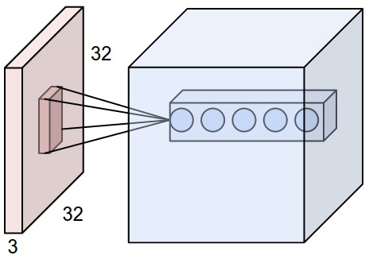
Alternate Representation:
Commonly, you will see CNNs are represented in the form of the diagram below
In this case, you have an RGB image of size 32x32x3 and we use 5 filters of size 5x5x3.
Notice, here depth of filter is 3 while in last slide depth of filter was 1.
This happens because the input to the conv layer has 3 planes (32x32x3)
This representation is mathematically similar to the last one but we compactly use the below form.
28x28x5
An example input volume in red (an image of size 32x32x3)
an example volume of neurons in the first Convolutional layer
5 neurons looking at the same region in the input i.e. depth of the convolutional layer
Each neuron in the convolutional layer is connected only to a local region in the input volume spatially, but to the full depth (i.e. all color channels).
Filter of size 5x5x3

Slide 9
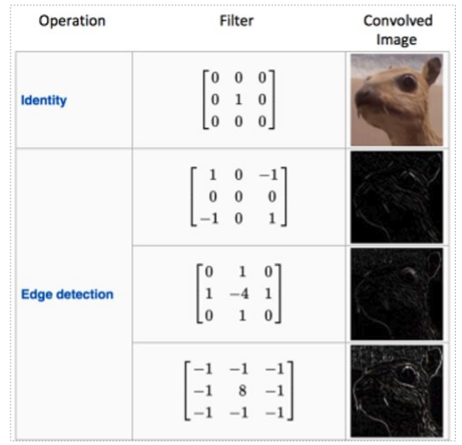
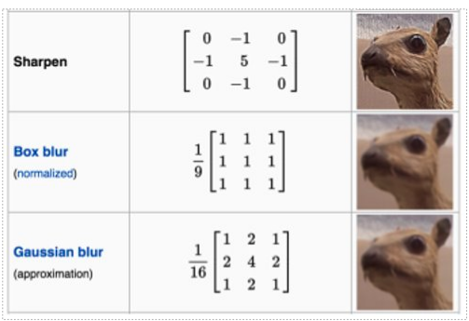
Filters Intuition
In CNNs, the filters perform convolutions and are the learnable parameters.
These filter parameters extract complex features from your input data.
Below are some commonly used human-crafted features with their functionality.

Slide 10
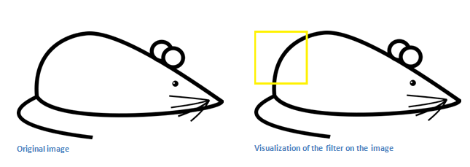
Convolution - Intuition
A curve detector filter when convolved on a curve in the input image should result in a high number.
Source: https://adeshpande3.github.io

Slide 11
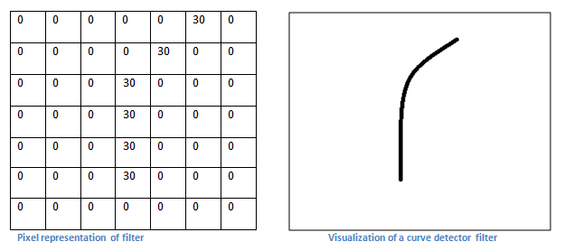
Convolution - Intuition
Source: https://adeshpande3.github.io

Slide 12
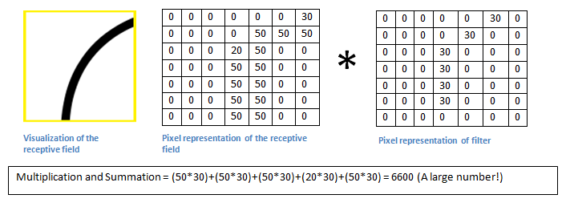
Convolution - Intuition
In the input image, if there is a shape that generally resembles the curve that this filter is representing, then all of the multiplications summed together will result in a large value!
Source: https://adeshpande3.github.io

Slide 13
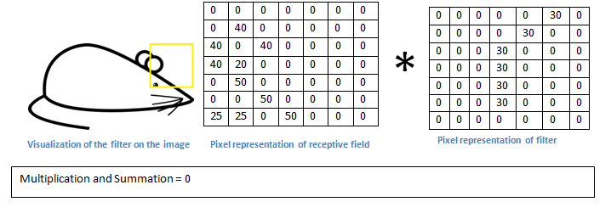
Convolution - Intuition
Source: https://adeshpande3.github.io

Slide 14
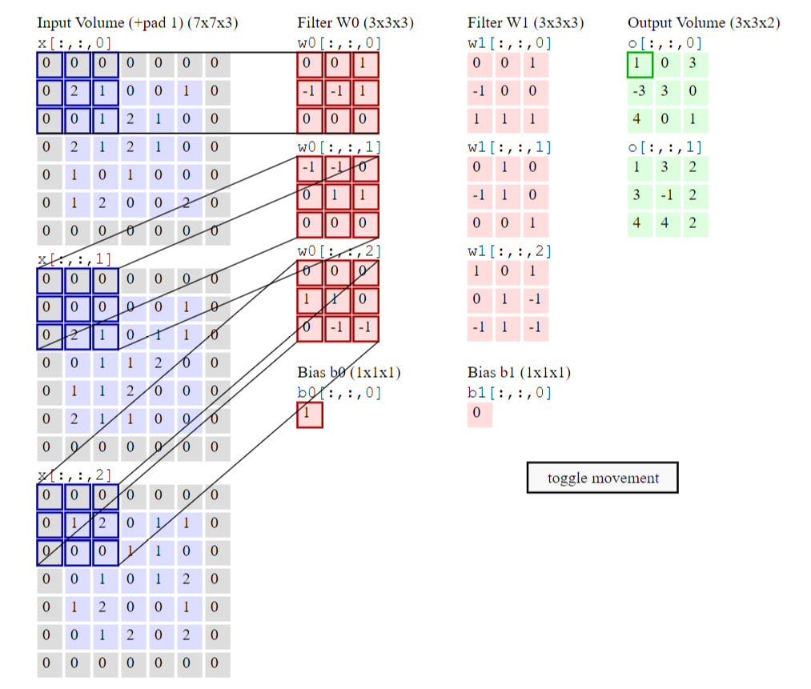
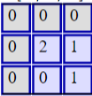
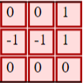
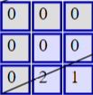
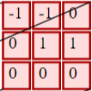
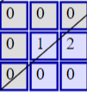
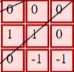
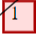
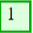
Convolution
3 channel input (RGB)
2 sets of filters
Each set size is the # of input channels
Creates 2 channels of outputs, called “feature maps”
*
*
*
Bias b0
Source: http://cs231n.github.io/convolutional-networks/

Slide 15
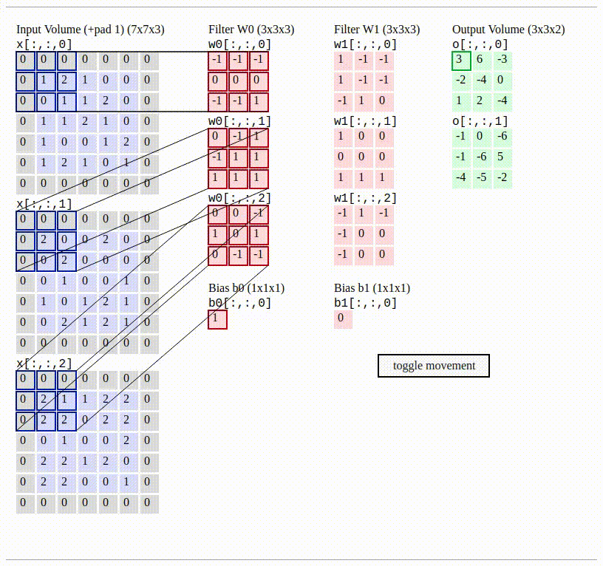
Convolution Demo:
Source: http://cs231n.github.io/convolutional-networks/

Slide 16
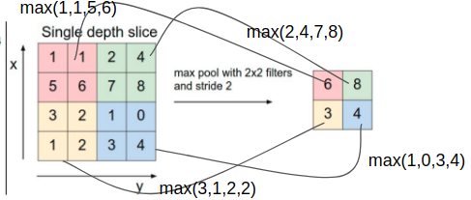
Pooling or subsampling
In CNNs, it is common to periodically insert a Pooling layer in-between Conv layers.
The idea is to reduce the spatial size of the representation to reduce the amount of parameters and computation in the network, and hence to also control overfitting.
Common types of Pooling: Max Pooling, Average Pooling
Note: Pooling layer does not have learnable parameters.
In the figure below, we use filter of 2x2 for pooling as shown in different colored blocks in the input data.
Stride is the displacement of filter. So, for stride = 2, we move the filter by 2 locations in x. Similarly in y.
So, in each window we perform max pooling or average pooling operation to get a single value.
Max Pooling Calculation
Similarly, for Average pooling, you take the average of all the values in a block.
For example: for first block: (1+1+5+6)/4 = 3.25
Source: http://cs231n.github.io/convolutional-networks/
Notes:
We can ask students to perform average pooling as a problem.

Slide 17
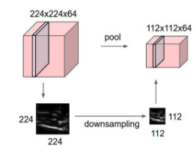
Pooling Example
Pooling layer downsamples the volume spatially, independently in each depth slice of the input volume.
In this example, the input volume of size [224x224x64] is pooled with filter size 2, stride 2 into output volume of size [112x112x64].
Notice that the volume depth is preserved.

Slide 18
Design Calculations for LeNet Architecture
Softmax
Step 1 - Calculations for Conv layer 1 (conv1 or C1)
Width and height of Image, W or H = 32
Number of filters for conv1, N = 6
Filter size = 5x5. Thus F =5.
Stride, S= 1
Padding, P= 0
Output width of the conv layer is given by (W-F+2P)/S + 1 = (32-5+2*0)/1 +1 = 28
Output height of the conv layer is given by (H-F+2P)/S + 1 = (32-5+2*0)/1 +1 = 28
Thus, output activation maps will be of size (28,28,6) where 6 is the number of filter as shown

Slide 19
Design Calculations for LeNet Architecture
Softmax
Step 2 - Calculations for SubSampling or Pooling (S2)
Input to sampling layer is feature maps of size 28x28x6. (W1xH1xD1)
For Pooling we are using, stride = 2, and filter size = 2x2, thus F =2.
Thus, the output volume sizes are
W2 = (W1-F)/S + 1
H2 = (H1-F)/S + 1
D2 = D1
So, we have S2 equals to (W2,H2,D2) = (14,14,6)

Slide 20
Design Calculations for LeNet Architecture
Softmax
Step 3 - Calculations for Conv layer 2 (conv2 or C3)
Input Volume - (14,14,6)
Filter size - (5x5x6)
Number of filters - 16
Stride =1, and padding = 0
Similar from step 1 output activation map has size (10x10x16)

Slide 21
Design Calculations for LeNet Architecture
Softmax
Step 4 - Calculations for SubSampling or Pooling (S4)
Input to sampling layer is feature maps of size 10x10x16. (W3xH3xD3)
For Pooling we are using, stride = 2, and filter size = 2x2, thus F =2.
Same as step 2, we obtain output of size (5,5,16)

Slide 22
Design Calculations for LeNet Architecture
Softmax
Step 5: Flattening
Now your convolution layers are ready.
In the next step, you will flatten the feature maps in S4 (5,5,16) to a single vector of size 5*5*16=400
Now, your input will be similar to the Neural Network.

Slide 23
Design Calculations for LeNet Architecture
Softmax
Step 6: Fully Connected 1 (fc1) layer (C5)
Input size - 400x1
Now, you have choose Number Neurons for FC layer. In our case it’s 120.

Slide 24
Design Calculations for LeNet Architecture
Softmax
Step 7: Fully Connected 2 (fc2) layer (F6)
Now, you have to choose Number Neurons for FC 2 layer. In our case it’s 84.

Slide 25
Design Calculations for LeNet Architecture
Softmax
Step 8: Final layer
In this layer, your number of neuron will be equal to number of classes.
In our case, we will be using the 10 numerical digits, hence need 10 classes.
So, in fact you should see that the picture example should not have shown an “A”,
but instead should have shown a numerical digit. Thus, for any numerical digit
used in training, that would then lead to 10 possible classes of digits.

Slide 26
Design Calculations for LeNet Architecture
Softmax
Step 8: Softmax layer
Notes:
Change softmax

Slide 27
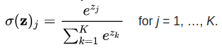
Softmax
Recall the idea from the last presentation where you saw binary classification of odd and even.
In binary classification, the output is the probability between 0 to 1.
Softmax extends this idea into a multi-class. That is, Softmax assigns decimal probabilities to each class in a multi-class problem. Those decimal probabilities must add up to 1.0.
If the input is 3, output is presented by a vector of length 10 with it’s 4th location as 1.
Equation below represents Softmax, where σ(z)_{j} is probability of z being class j and z is the output vector from the CNN and K is the number of classes.
0
0
0
1
0
0
0
0
0
0
0
0
0
0
0
0
0
1
0
0
Softmax
For input = 3
For input = 7

Slide 28
Convolution + ReLU
From the slide 5, you can see that in convolution networks after conv layer we add a ReLU or activation layer.
ReLU is added to introduce a non-linearity in the convolutional layer. (You have previously seen sigmoid.)
Introducing this nonlinearity gives CNNs the power to capture non-linear patterns in your data.
ReLU is a commonly used activation function in practice but there are other activations such as sigmoid, tanh etc. as mentioned in the Neural Network lecture earlier.

Slide 29
Summary
CNNs are compact representation of Neural networks used for image understanding.
CNNs are built using set of conv layers, pooling layers, activations functions, and fully connected layers connected in a specific manner.
Conv layer has filters which are the learnable parameters of the network, while pooling layer has not parameters and lastly, fully connected layers parameters are same as Neural Network parameters.
Softmax is often used for Multi-class classification.
The training procedure for CNN is same as that of Neural network but your data is in the form of 2-D (generally images).

